Slide 1

U.S. Treasury – Spending USA| Challenge X Final Presentation

Slide 2
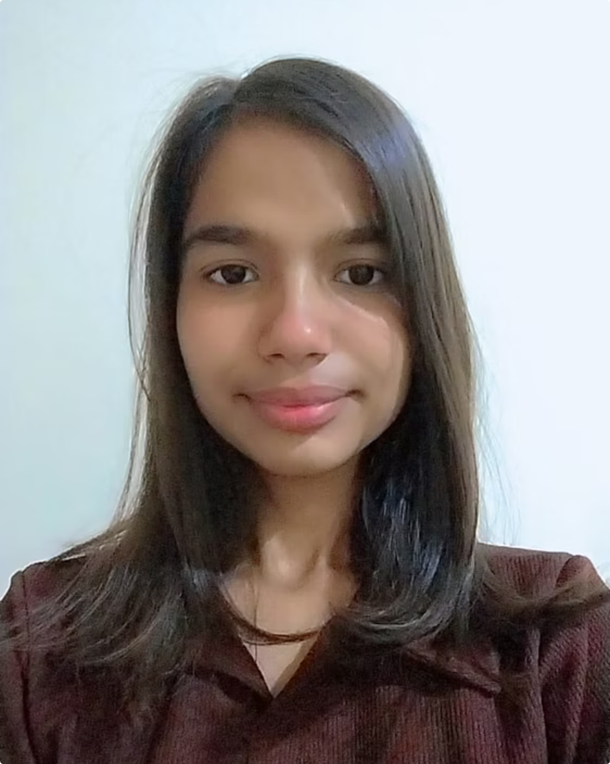
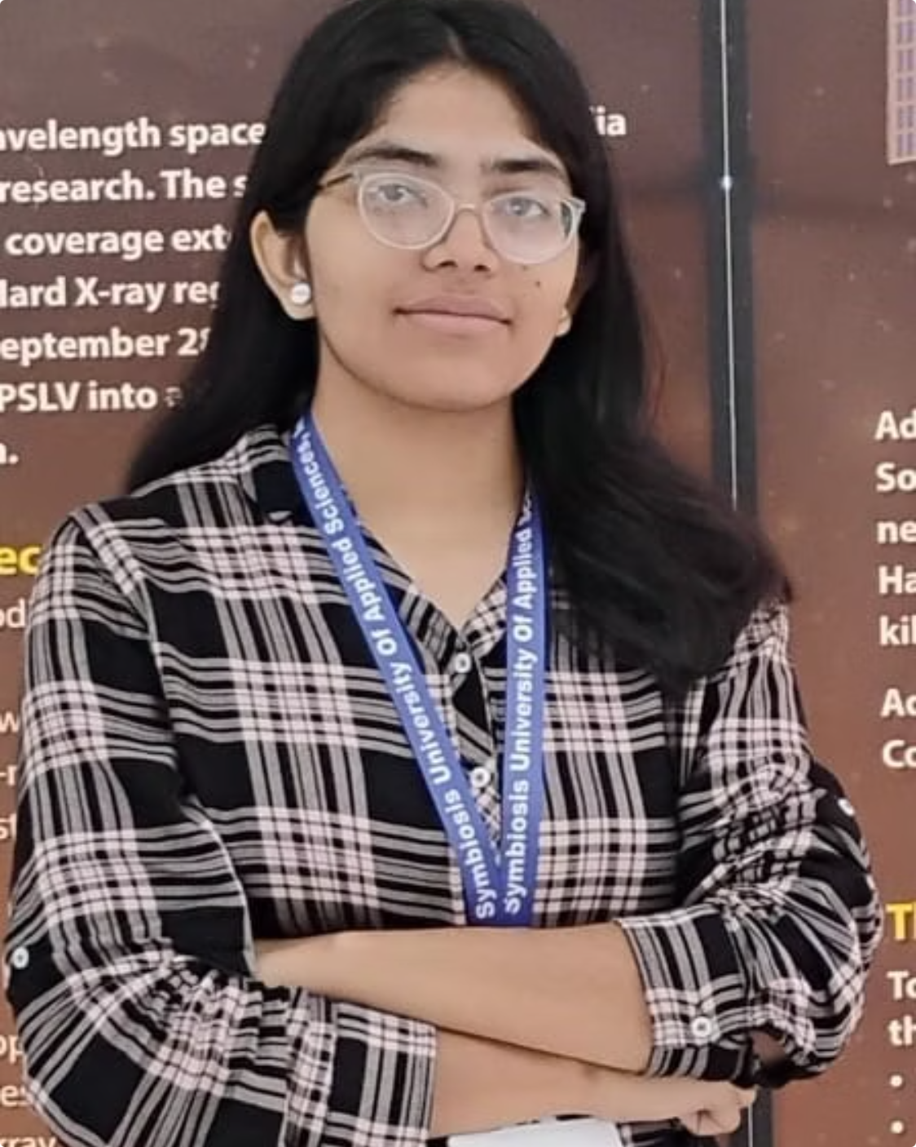
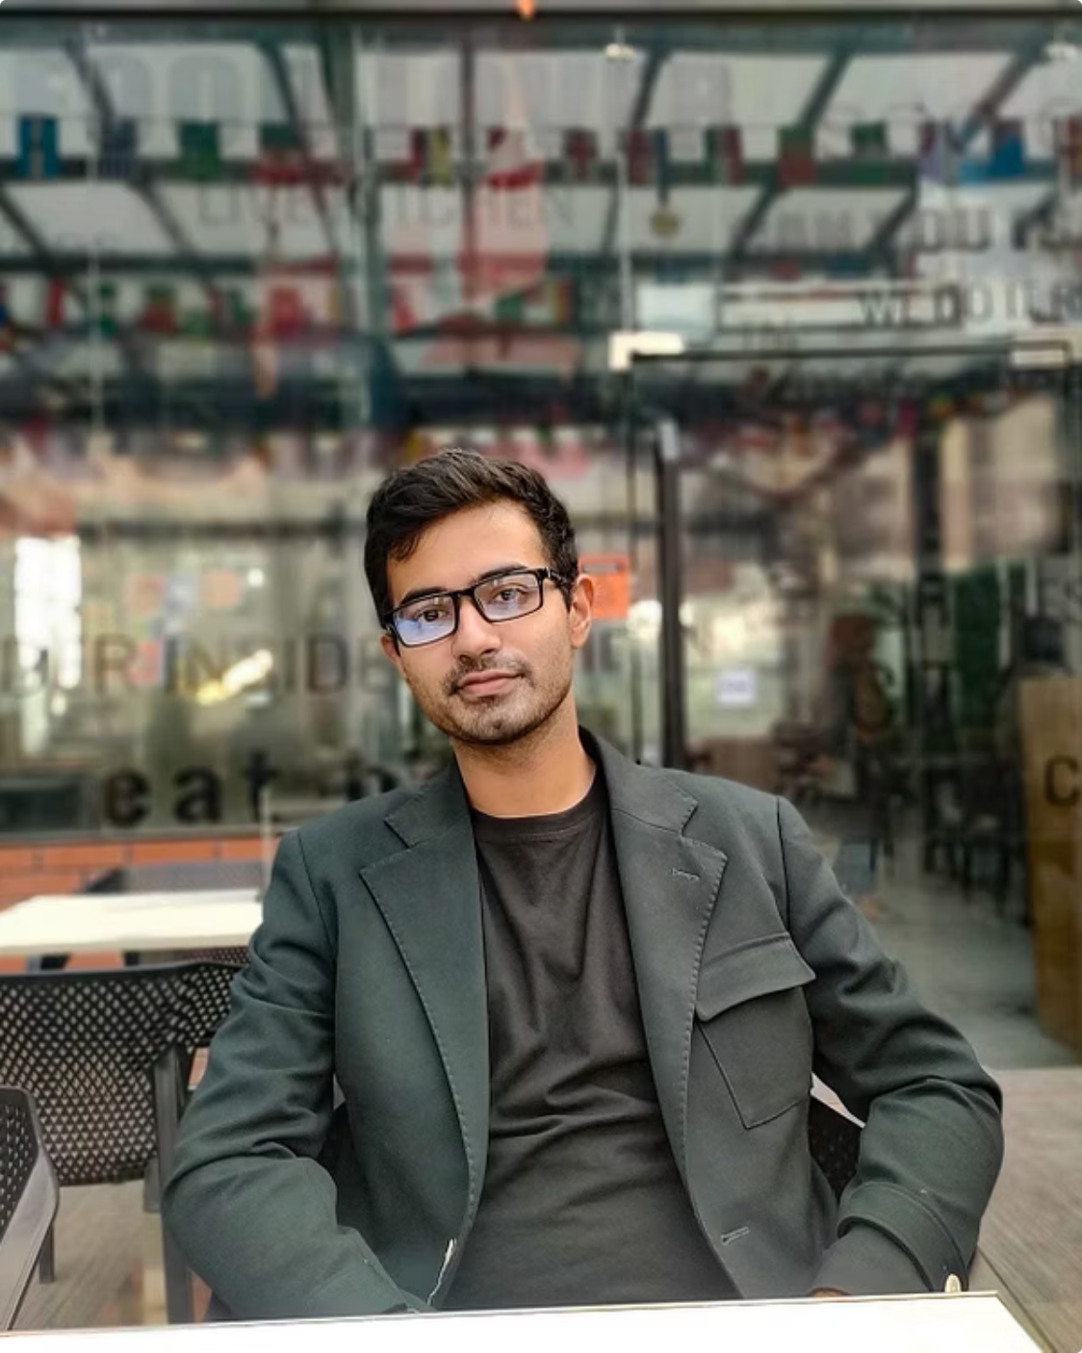
Meet Team Asyncode
Sandhya Pal
Shreya Rai
Tahsin Mahamud
SUAS Representative
SUAS Representative
GMU Representative
Our diverse team from George Mason University (GMU) and SUAS brought together varied expertise for the Challenge X Hackathon.

Slide 3

Team Naming Concept: Asyncode
Our team name, Asyncode, reflects our commitment to asynchronous collaboration and efficient coding, embodying the agile spirit of hackathons and modern development practices.

Slide 4
Project Objective
To develop the "Local Impact Assistant," a cutting-edge tool designed to help the U.S. Treasury better understand and measure the economic impact of federal funding at the local level. Our goal is to enhance transparency and accountability.
Enhanced Transparency
Improved Accountability
Data-Driven Decisions
Clearly show how federal funds are utilized.
Track funding impact and ensure responsible spending.
Provide insights for informed policy-making.
Interactive and Fun
Created an interactive way to use and gain knowledge about the data

Slide 5

Our Thought Process
01
Identify the task
Finding a user friendly way to engage with the data
02
Brainstorm Solutions
Unanimous decision of gamifying aspect
03
User-Centric Design
Focusing on ease of use
04
Iterative Development
Building and refining the prototype throughout the journey .

Slide 6
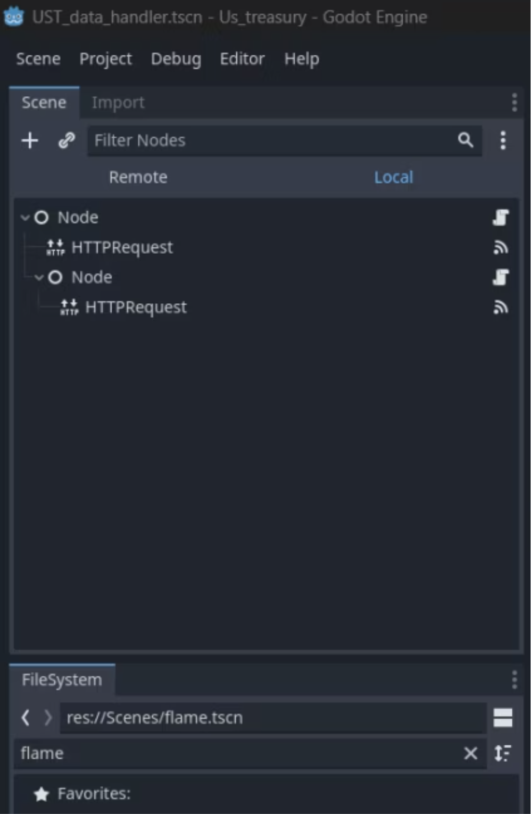

Core Idea:
Our idea is Local impact awareness, a simple app that helps people explore nearby federally funded projects through an interactive map and light game-style experience. Users can tap locations, view project details, access dens where to access and learn the data through a gamified experience.
Challenges:
learning to use the U.S. Treasury API,
overload of the Gemini API
making the game elements work under tight time,
and coordinating everything asynchronously across U.S.–India time zones.
The overloading of the Gemini API was handled by using it once to create 20 questions and saving them into a usable Json file
This picture shows the node structure in Godot used to handle the two APIs used.
(AT first we call the UST API and use it to extract the data, then we feed it to Gemni to create questions).

Slide 7

Challenges & Solutions
Gemini API Management
1
Challenge: Using the Gemini API without overloading it and hitting rate limits.
2
API Rate Limiting
Solution: Implemented intelligent request throttling and caching mechanisms.
UST API Integration
3
Challenge: Understanding how to properly use the U.S. Treasury API and its data structure.
4
API Documentation Study
Solution: Deep-dived into Treasury API documentation and tested endpoints iteratively.
Time Constraints
5
Challenge: Making the application work and function properly within such a short hackathon timeframe.
6
Agile Development
Solution: Prioritized core features and used rapid prototyping techniques.
Asynchronous Coordination
7
Challenge: Managing asynchronous work and collaboration across team members.

Slide 8
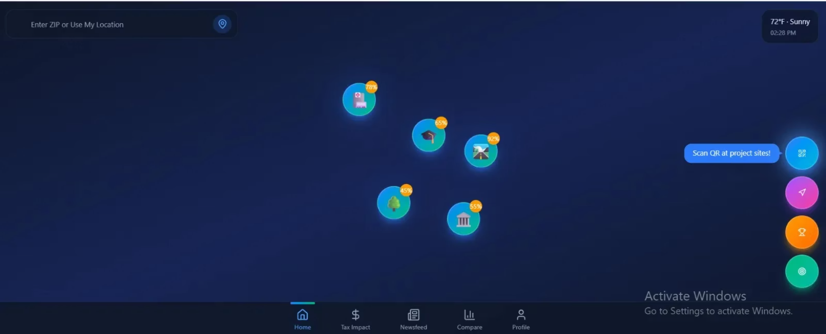
UI Design and first idea
This UI would provide real time locations as popups to learn about UST Spending.
One can access the information, and get in, into 'dens' to interact with the game.
Alternatively the user could scan a QR code in specific locations leading them to the game itself.

Slide 9

Choice of the Engine:
We choose Godot for the familiarity with python, without needing for all the members to learn C# or C++.
It is free.
And one member has already experience with the engine

Slide 10
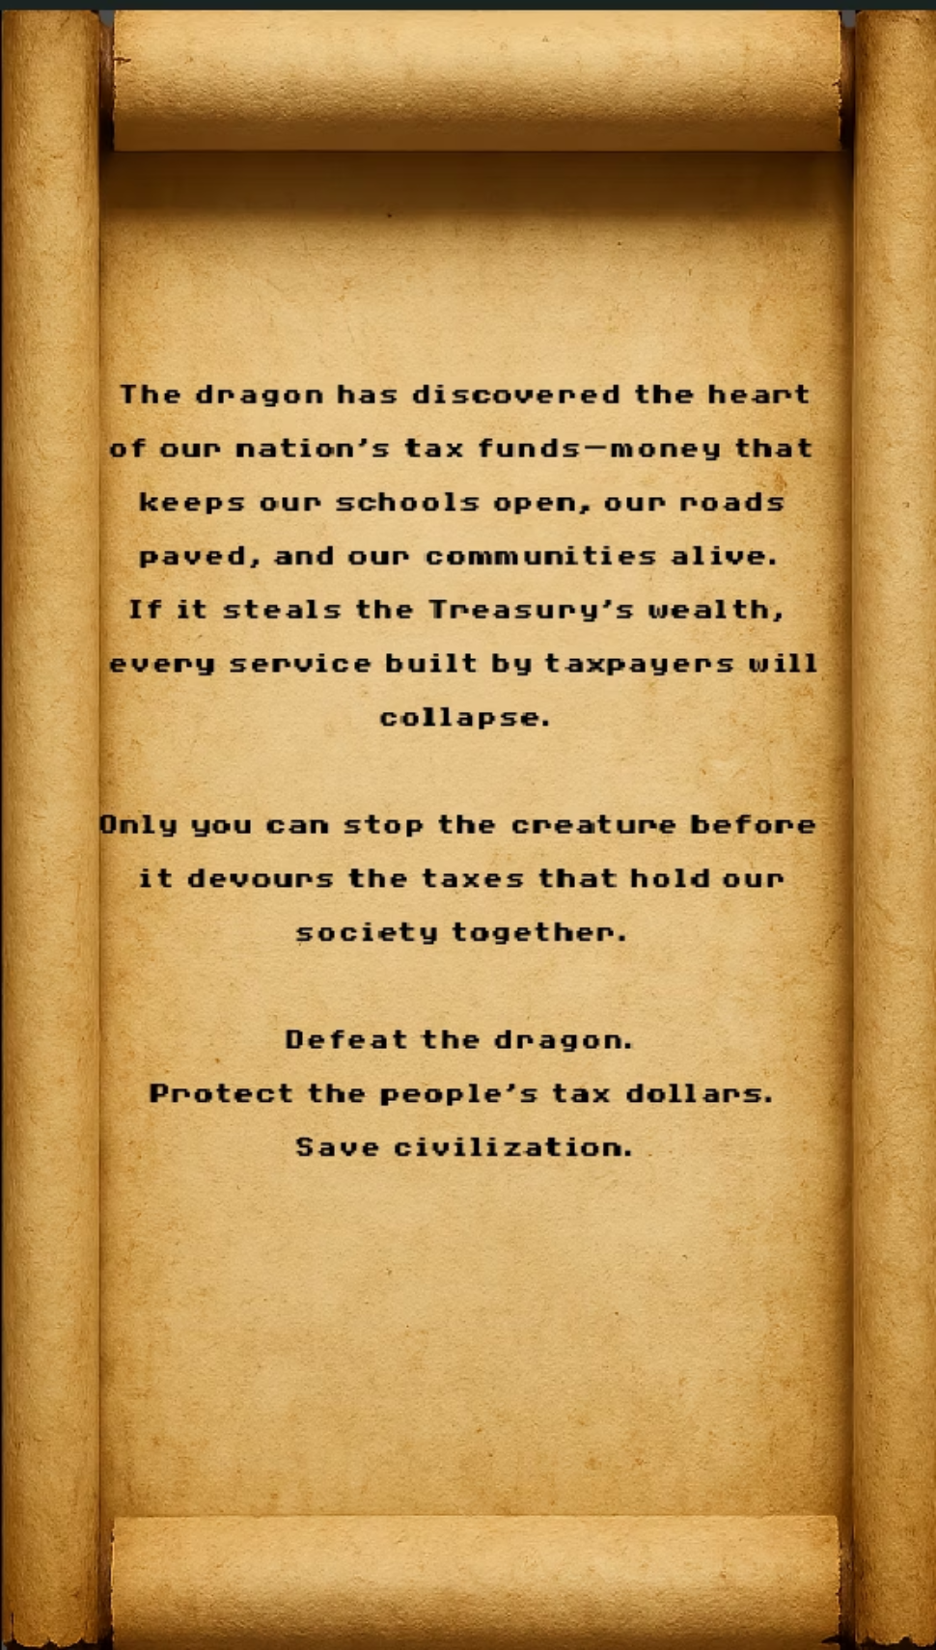
Story of the game:
It is a pun to the word "Treasury". Treasure - y,
Mythologically dragons are known for being attracted to treasures/guarding treasures.
So it would be fun to roleplay as the protector of the treasury from the greedy dragon.
Note: A story based introduction with dialogues between the player and a villager explaining the game and the story was planned but not executed due to time constrains.

Slide 11
Current prototype:
Accesses UST API and extracts information relative to location (state based)
Creates simple quizzes with two options (one correct the other incorrect )
Swipe based gameplay to simulate mobile gameplay
Animations to make the game look more vivid

Slide 12

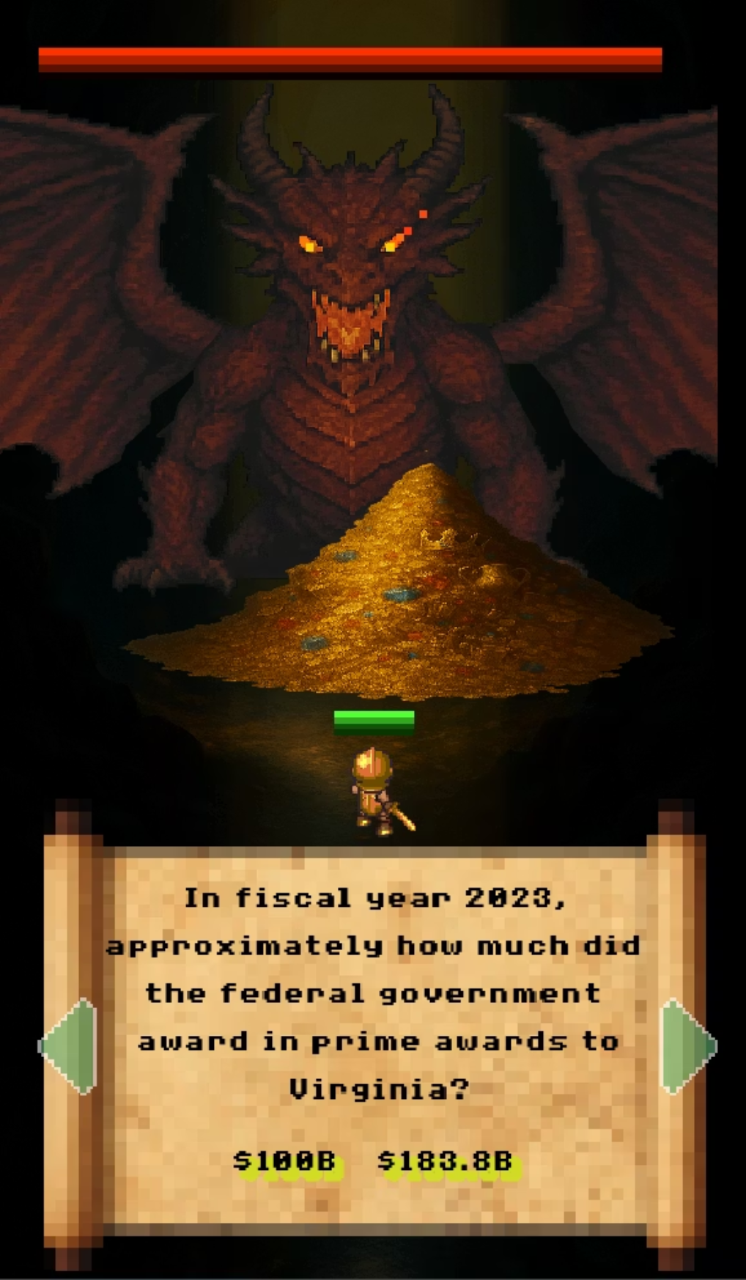
Final Product Preview
Here's a glimpse of the 'USA Treasure-y knight' in action, showcasing its intuitive interface and powerful analytical capabilities.
We will demonstrate how the game works in demo

Slide 13
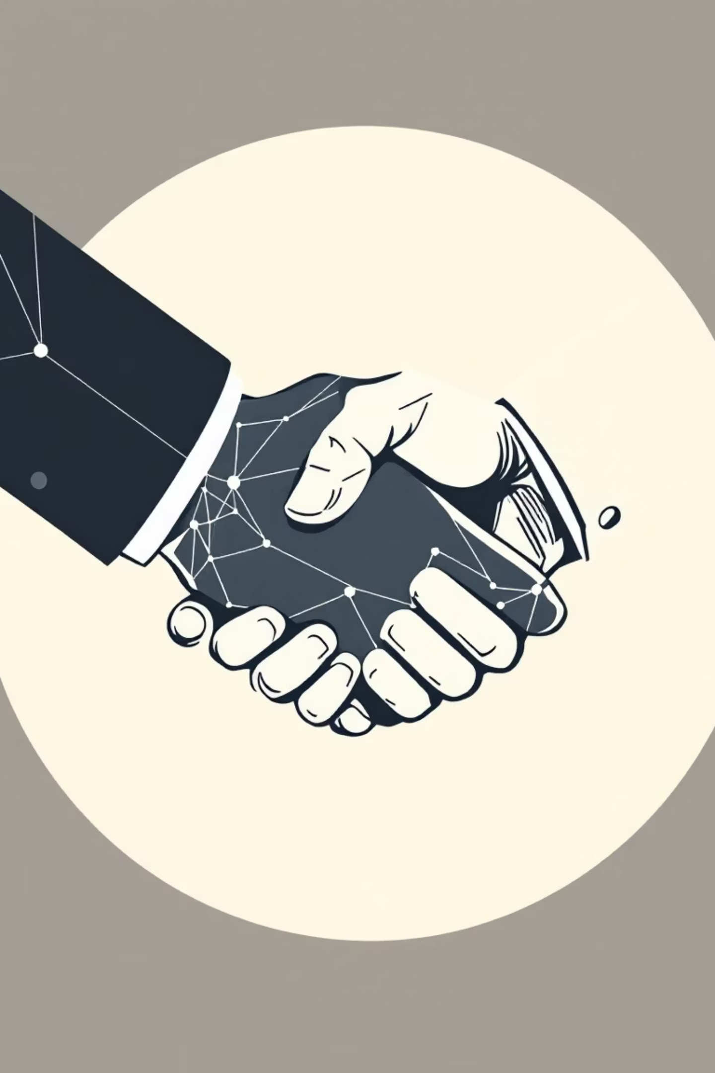
Thank You
We appreciate your time and consideration. We believe our project has the potential to significantly enhance the U.S. Treasury's ability to invoke interest in people about the impacts of their taxes in the real world.

